Slide 1

04-800 AB Machine Learning for Earth Observation: LAB1
Session: Introduction to ArcGIS Pro
On 25th January 2024
Spring 2024

Slide 2
Agenda
GIS overview
Create a project in ArcGIS Pro.
Add data to a project.
Update the Geodatabase.
Add files to the database.
Export feature layers to the database.
Coordinate systems.
Create a region of interest.
Export to shapefile.
Create a layout.
Handin (what to submit)

Slide 3
GIS Overview
Geographic Information System (GIS): is a computer system that captures, stores, checks, and displays Earth's surface-related data, enabling a comprehensive understanding of spatial patterns and relationships by linking seemingly unrelated information.
Common examples of GIS softwares:
ArcGIS Pro
QGIS (Open source)
This lab will only focus on the basic introduction to ArcGIS Pro (Per the agenda).

Slide 4
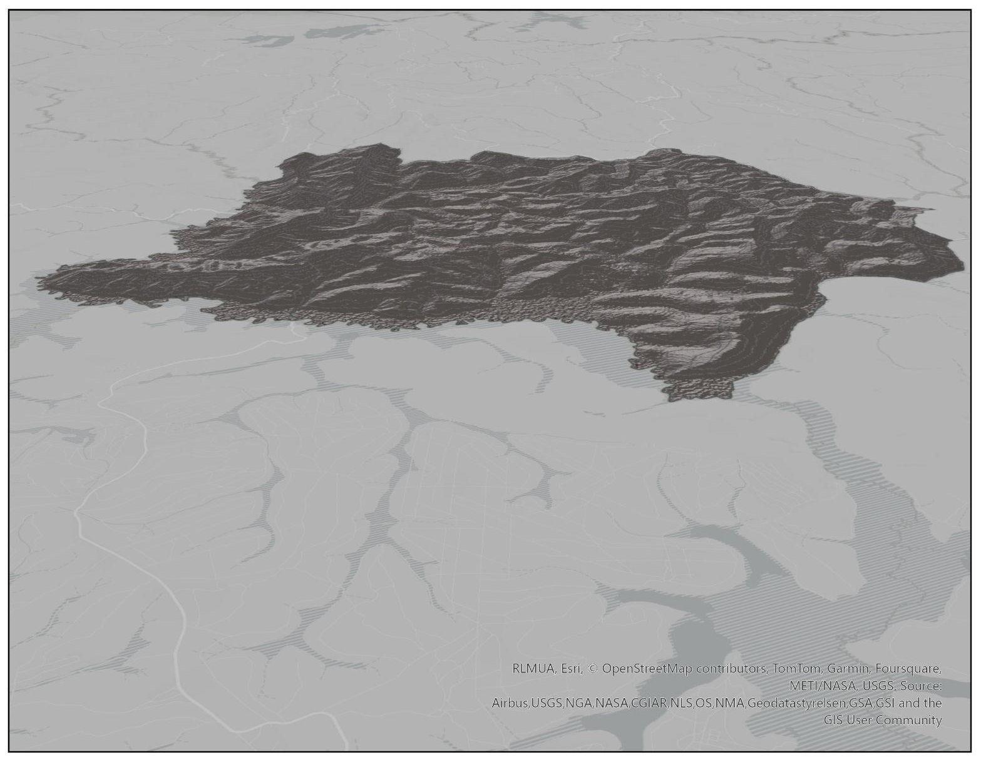
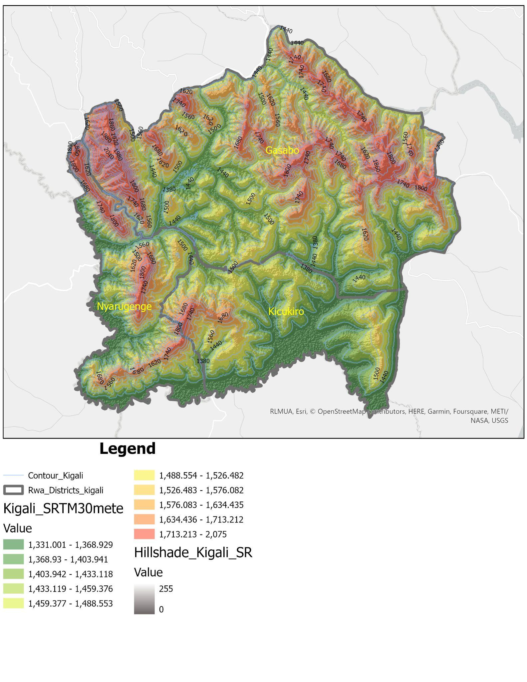
GIS Overview (Cont’d)
Examples of Application:
Kigali City Master Plan 2020
Malaria prevalence (Dashboard)
In flood monitoring (Kigali Elevation model)

Slide 5
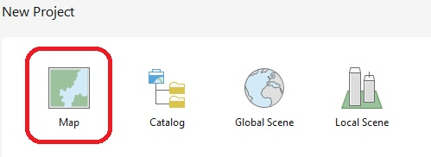
Create a project in ArcGIS Pro.
Start ArcGIS Pro
On the start page, under New Project, click Map
Type your project name (ML4EO_Lab1_AndrewId)
Specify the project files location

Slide 6
Create a project in ArcGIS Pro. (cont’d)
Tick create a new folder for this project. (Experiment: create a project and untick create a new folder for this project and note the difference)
Click ok
Close ArcGIS and check the location where you saved your project.
Open .aprx (ArcGIS project file)

Slide 7
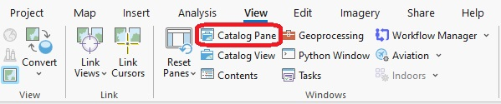
Create a project in ArcGIS Pro. (cont’d)
Renaming the map:
Under the view tab, in the windows group , click on catalog pane.
On the catalog pane, expand the maps folder and rename the map to lab1_map.

Slide 8
Create a project in ArcGIS Pro. (cont’d)
Add basemap:
Under Map tab, in the layer group, expand Basemap and select Light Gray Canvas.
On the content pane, remove Light Gray Reference.
Save the project.

Slide 9

Add data to a project
Under map tab in Layer group
Click add data
Select data (World shapefile)
Click ok

Slide 10
Add data to a project (cont’d)
Create a Bookmark:
Zoom in to region of interest (Africa in this case)
On the Map tab, in the Navigate group, click Bookmarks
Click on new bookmark and provide necessary inputs
Experiment: (Create bookmark for Burundi, Rwanda, Uganda)
Symbolize a layer (no color fill, black outline of 1.5 pt width)

Slide 11
Update the Geodatabase
Creating folder connection
Under View tab in Windows group
Click on Catalog pane
Right click on Folders
Select Add Folder Connection
Browse desired folder
Select the folder and click Ok
The data in connected folder can be added to the database or current map via catalog pane

Slide 12
Update the Geodatabase cont’d
Export feature layers to the database
Analysis tools
Export feature layers to the database
Shortcut
Under Analysis tab in Geoprocessing group
Click tools
Search Export Features (Conversion tools)
Fill the required fields
run the tool
Right click on the feature in content pane
Drop down on Data
Choose Export feature
Fill the required fields
Click Ok

Slide 13
Coordinate systems
Geographic Coordinates Systems (3D)
Expressed in angular Units
Projected Coordinates Systems (2D)
Expressed in linear units

Slide 14
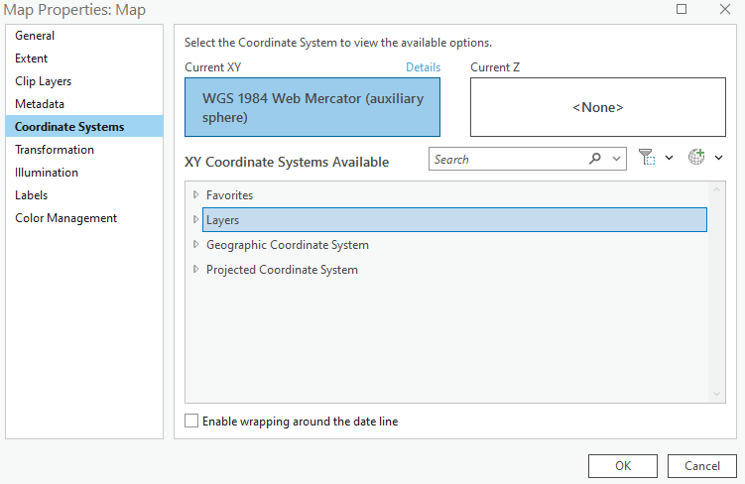
Coordinate systems (cont’d)
Add the world shapefile to the map.
On the content pane, right click on the map, go to properties, go to coordinates systems.

Slide 15
Coordinate systems (cont’d)
Select a coordinate system and check the details (Geographic)
Select the projected coordinate system and check the details
Experiment: Try the following projected coordinate systems and note the difference on the map.
https://surferhelp.goldensoftware.com/projections/Characteristics_of_Projections.htm
CS | Category | True measurements | Measured units
Bonne | (World) | -Australia: 7.688 million km² -Distance btn Africa & Australia: 10,503 km | Area: Distance:
Equidistant conic | (World) |  | Area: Distance:

Slide 16
Create a region of interest (cliping)
By using the analysis tool:
Set the CS to WGS 1984 (Geographic coordinates system)
Add Africa shapefile to the map or use existing one
Go to analysis tab, in the geoprocessing group, click on tools.
In the search box, type clip and choose clip (Analysis tools)

Slide 17
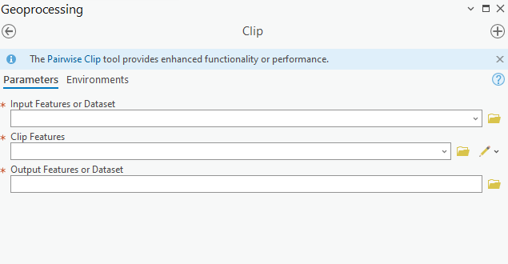
Create a region of interest (cliping)
By using the analysis tool:
Use world_boundaries layer as input features
Use Africa_boundaries layer as clip features
Rename the output feature to Africa_boundaries_clipped
Run the tool and symbolize the layer if necessary

Slide 18
Create a region of interest
By location:
Remove all layer from the content pane and keep Africa_boundaries_clipped layer only
Label with the country name
Zoom to clearly see Rwanda and Burundi
Go to map tap, in the selection group, expand selection and choose rectangle
On the map, select Rwanda boundary, hold the shift key and select Burundi
Use shortcut to export the feature (export data) to database and name the output feature as Rwanda_Burundi

Slide 19
Export to shapefile.
Expand the project geodatabase, on the catalog pane
Right click on Rwanda_Burundi feature class
Expand export and choose feature class to shapefiles
Choose where to save the output feature class and name it Rwanda Burundi
Run the tool
Check the files destination and organize them

Slide 20
Create a layout
On the Insert tab, click the New Layout button , click ANSI – Portrait, and click Letter 8.5” × 11”.
In the Catalog pane, rename the layout Africa.
In the contents pane, right-click the layout name (Africa) and click Zoom Page.
On the Insert tab, in the Map Frames group, click the Map Frame arrow, select the Africa map with the Default Extent, click and drag a bounding box.
Zoom to the desired map view.

Slide 21
Create a layout (Cont’d)
Note: Activate or deactivate the layout
Add legends: On the Insert tab, in the Map Surrounds group, click the Legend button, and drag a rectangle.
In the calog pane, right click on the layout name, go to export to File.
Fill export properties: file type (JPEG) and name the file and choose the location.
Click on export.

Slide 22
Handin (What to submit)
Export the map layout that you have created in this lab as a jpg file to the project folder.
Zip your completed project folder and submit on Canvas
Deadline: Today, 11:59

